Slide 1


Operating System (114 Autumn)
Chun-Feng Wu (吳俊峯)
Assistant Professor, National Yang Ming Chiao Tung University
cfwu417@cs.nycu.edu.tw
https://cfwu417.github.io

Slide 2
A Few Heads Up
Please register a time slot before 9/17 23:59.
We will randomly assign a paper and a time slot for those who do not register.
Welcome to ask any questions in class. (2 points per question, Max: 6 points)
Please send an email to os.oscarlab@gmail.com
The content shall include: (1) name, (2) student ID, (3) date of the class, (4) your question in class, (5) and a screenshot of your question if you ask via the chat box.

Slide 3
Remind– Paper Presentation
Should join online when you need to do the presentation.
https://nycu.webex.com/meet/cfwu417
Welcome everyone to join paper presentations online every Friday.
What do we expect for the presentation (6-8min):
Background, Trend (~2min)
Related Works & Observation & Motivation (~2min)
Methodology Concepts (~3min)
Criteria:
Make the motivation clear enough. (Organize the flow from background to related works and to challenges clear)
Let the presentation easy-to-follow. (Some animations can help.)
Point out the design concept of the methodology? (Do not go through the algorithm, please extract the high-level concept.)
Do not let the presentation go over 8 mins. (Penalty: 20% off)

Slide 4
L1: Operating Systems a Recap
Notes:
Good Morning, My name is Chun-Feng Wu. In this presentation, I will briefly introduce myself and share some key idea of my researches.
Intensive data movement is one of the critical issue when Von-Neumann machines enter the big data era.
To deal with this issue, my research is to enable a fast, large and device-friendly next-generation computing system.

Slide 5
Agenda
Computer System Organization
What is Operating Systems & Linux Kernel
Operating System Structure
What topics will we cover
Process & Interrupts
Main Memory Management
I/O Devices & Device Driver
File System
Challenge of OS
Advance Topics: Graph Systems, Deep Recommendation System, Key-Value Database, Deduplication, Data Center Computing, Virtualization Concepts
Notes:
This is the agenda.
I will first give a brief self-introduction including awards, cooperation experiences, and publication.
After that, I will give a deep dive into my research – the next-generation computing system, and present my future plan.
I will then talk about the reason for applying your department, as well as my course plan in the end of presentation.

Slide 6
Computer Organization
Introduction: Computing devices, memory devices (e.g., DRAM), and I/O devices (e.g., HDD, SDD, or network devices) are three main basic components.
Software: The collection of programs, data, and instructions.
Von-Neumann Architecture:
CPU fetches an instruction from memory.
Then, CPU decodes and executes the instruction.
CPU fetches next data (Automatically Increment PC).
Challenges without Operating Systems:
CPU will be solely occupied by one process.
CPU shall wait for I/O devices. (1 ns vs 100 us).
CPU cannot understand ”file” in I/O devices.
Compute (e.g., CPU)
Control Unit
ALU
PC
Inst 1
PC
PC
Inst 2
Inst 3
Memory (e.g., DRAM, NVM)
.
.
.
Sol: Process Scheduler
I/O (e.g., HDD, SSD)
Sol: Page Fault Handler & Context Switch
Sol: Device Driver & File System
CPU only does routine work!

Slide 7
Roles of Operating System (OS)
Goal: A software layer (middleware) stands between applications and computer’s hardware. The role of an OS is to coordinate and manage hardware devices. (e.g., CPU, memory, storage devices).
OS’s Roles:
Transparency: Users do not need to worry about hardware managements or contentions.
Resource Allocator: Manage CPU time, memory space and I/O resources.
Control Program: Prevent errors and improper use of computers.
Neural Networks
Web Browsers
Video Players
Control Program
Operating System
Resource Allocator
Computer Hardware
Computing Devices
Memory Devices
I/O Devices

Slide 8
Roles of Operating System (Count.)
Goal: A software layer (middleware) stands between applications and computer’s hardware. The role of an OS is to coordinate and manage hardware devices. (e.g., CPU, memory, storage devices).
Well-Known Components:
Process Scheduler: Fairly allocate CPU resources to applications.
Memory Manager: Allocate memory, locate pages, reclaim memory.
Block I/O Layer: Manage I/O requests (Merge & Schedule I/O)
File System: Locate file contents, partition devices, control permission.
Neural Networks
Web Browsers
Video Players
Operating System
Process Scheduler
Memory Manager
File System
Block I/O Layer
Computer Hardware
Computing Devices
Memory Devices
I/O Devices

Slide 9
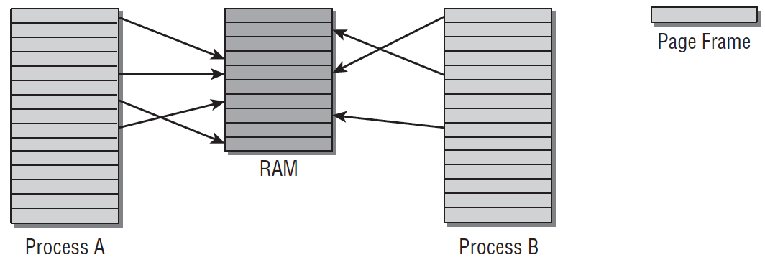
What is Linux Kernel
Linux Kernel: A process manager consists of a bunch of C and Assembly code.
Is Linux Kernel a Process: No, Not exactly.
Each process shall have their own virtual address space.
Virtual address space makes programming easier!
Fixed size (e.g., 4KB) solves fragmentation!
Page
Page
Table
Page Frame (4KB)
Data
Process B doesn’t need to know the data is swapped! So no code is changed.
Non-Present
Swap!
Physical Address Space
Change B’s page table.
pte_to_swap_entry()
Virtual Address Space
Virtual Address Space
Storage (e.g., HDD, SSD)

Slide 10
What is Linux Kernel (Count.)
Linux Kernel: A process manager consists of a bunch of C and Assembly code.
Is Linux Kernel a Process: No, Not exactly.
Each process shall have their own virtual address space.
Page
Page
Table
Page Frame (4KB)
Kernel Address Space (Virtual)
User Program
User Address Space (Virtual)
Physical Address Space
Virtual Address Space
Virtual Address Space
Process Data
Main Memory

Slide 11

What is Linux Kernel (Count.)
Linux Kernel: A process manager consists of a bunch of C and Assembly code.
Is Linux Kernel a Process: No, Not exactly.
Each process shall have their own virtual address space.
Kernel runs as part of a user process. (Noting: A specific part of all processes’ virtual address space points to the same physical address storing kernel code.)
There are also some kernel processes working on monitoring system status. (Daemon)
Kernel Address Space (Virtual)
Page Fault Handler
CPU
Page Fault!!
User Mode
Kernel Mode
User Program
User Address Space (Virtual)
Process A
User Mode
Kernel Mode
Noting: CPU switches to kernel mode to access OS code. But, CPU does not need to switch the context!
Process Data
Process A
Main Memory
Notes:
每個行程的位址空間 & 核心在其中的位置
逐字翻譯
Each process shall have their own virtual address space. 每一個行程（process）都要有自己的虛擬位址空間。
Kernel runs as part of a user process. (Noting: A specific part of all processes’ virtual address space points to the same physical address storing kernel code.) 核心（Kernel）以「是使用者行程的一部分」的方式在執行。（注意：在所有行程的虛擬位址空間裡，都有某一段固定區域被對映到同一組實體位址，那裡放著核心程式碼/資料。）
There are also some kernel processes working on monitoring system status. (Daemon) 另外還有一些核心行程/背景常駐程式（daemon）在執行，用來監控與維護系統狀態。
解說（重點脈絡）
每個行程有自己的虛擬世界：程式看到的是「虛擬位址」，透過頁表映射到不同的「實體位址」。因此行程彼此隔離、互不干擾。
核心被映射到每個行程的高位區：為了讓系統呼叫/中斷能快速進核心而不必換另一個位址空間，OS 會把同一份核心程式碼與只讀資料映射到每個行程位址空間的某一段（通常是高位），但權限設成只允許特權級（內核態）存取，使用者態碰不到。
這讓從 user→kernel僅是權限等級切換，不是換行程也不是整個記憶體搬家。
實作細節：每個行程仍有自己的 kernel stack、task_struct 等，但核心程式碼頁是共用的同一份實體記憶體。
例外/補充：因 Meltdown，x86-64 常啟用 KPTI（把使用者與核心頁表更嚴格分離），不過進核心時仍會切到含有核心映射的頁表；概念仍是「核心映射對所有行程一致」。
核心行程 / 內核緒（kernel threads）：像 kthreadd、ksoftirqd、kswapd、kworker/* 等，它們：
在核心態執行、PID 看得到（通常以 [] 括號顯示），
不對應到任何使用者程式的可執行檔，
負責背景維護（換頁、回收記憶體、處理下半部、I/O 排程、監控等）。
一句話解釋
每個行程各有一個虛擬位址空間，其中一塊「只給核心用」的區域在所有行程都指到同一份核心實體記憶體；此外核心還有自己的背景工作緒負責系統維護。
白話解說
把電腦想成一棟大樓：
每個住戶（行程）有自己的房間（虛擬位址空間）；互相進不去。
大樓裡有一條維修通道（核心區），每戶的平面圖上都畫得到，但只有管理員（核心態）有鑰匙；通道其實是同一條實體走廊。
**管理員班表（kernel daemons）**像清潔、保全、機電維護，一直在巡邏，讓整棟大樓運作順暢。

Slide 12


How to Trigger/Request Kernel Services
When Do CPUs Run Kernel: CPUs runs the kernel only when some special events are triggered. Otherwise, it runs user programs or stays idle.
Special Events:
Hardware interrupts (Alerting signal)
Timer interrupt
I/O Interrupt (e.g., Keyboard, Hard Disks)
Software-generated interrupts (Traps or Exceptions)
Specific requests from user processes (System Call, such as Read/Write)
Some errors (e.g., invalid memory access or page faults)
System Call
Timer Interrupt
Context Switch
I/O Interrupt
User Mode
Process A
Process A
Process B
Kernel Mode
System Call Handler
Scheduler
I/O Handler
Scheduler

Slide 13
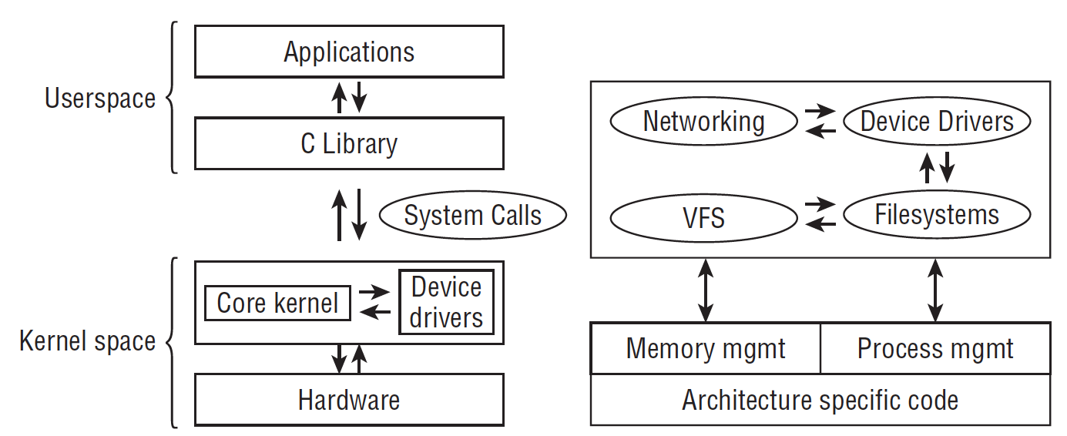
Put it all together: A High-Level Overview
User Space:
Applications (e.g., TensorFlow, Hadoop, Databases, Pytorch)
Libraries (e.g., C/C++ Library → Does Memory Allocation )
Kernel Space:
Device Drivers (Contact with I/O devices)
Core Kernel
Process Management
Memory Management
I/O Management
A High-level Overview of the Linux Kernel^{[1]}
[1] Mauerer, Wolfgang. Professional Linux kernel architecture. John Wiley & Sons, 2010

Slide 14
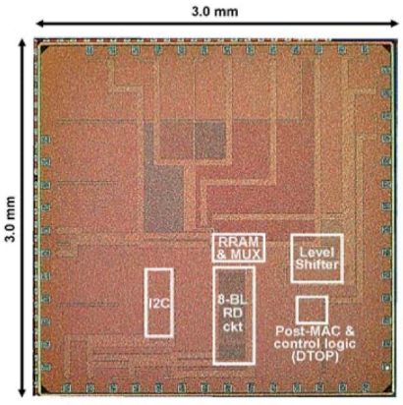
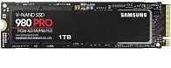
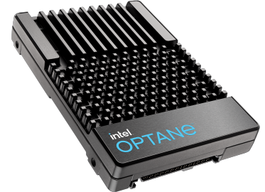
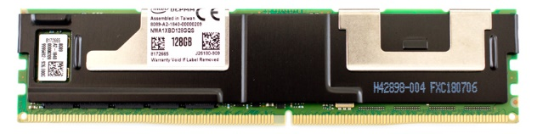

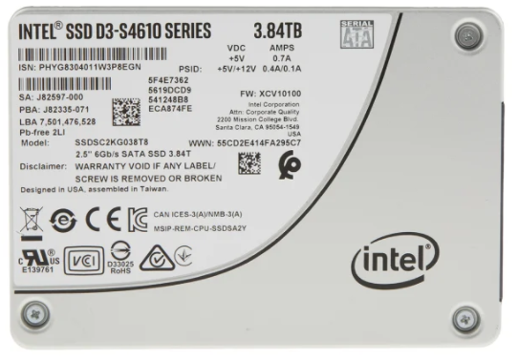
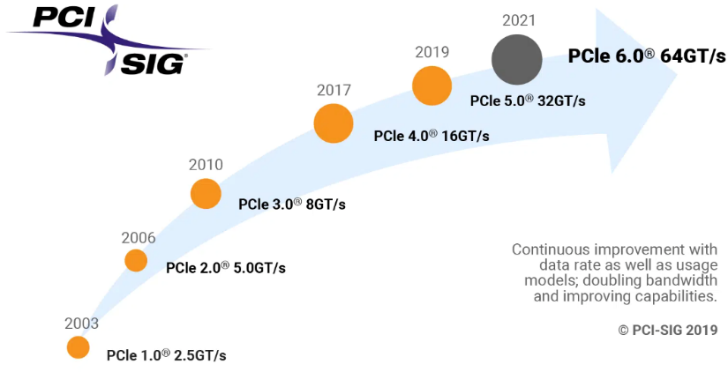
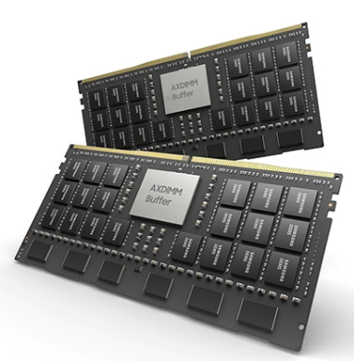
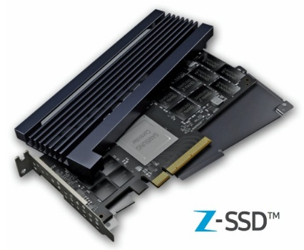
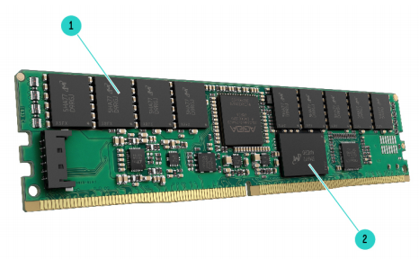
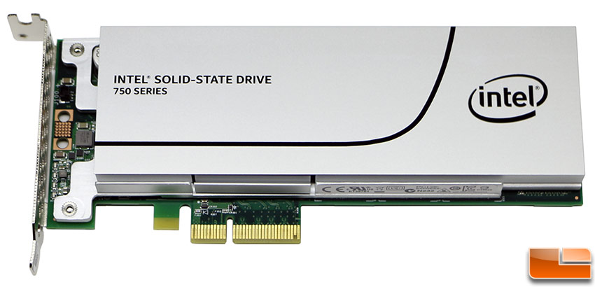
Emerging I/O Technologies
NVMe M.2 SSD
Intel Optane DC
Persistent Memory
Intel Optane SSD
TSMC PIM Chips
NVMe U.2 SSD
DRAM
NAND Flash
NVMe PCIe SSD
Samsung Z-NAND SSD
HPE NVDIMM
Samsung AXDIMM
High Throughput
3.98 GB/s
Ultra-Low Latency
~ 5 us
Storage-Class
Memory
Faster Data Buses
2011
2017
Now
Notes:
Fortunately, enterprises have launched several emerging devices to deal with the challenge of data movements.
In 2011, Intel initiated the first NVMe protocol to improve the throughput of peripheral buses.
(click)
In 2017, Samsung and Intel launched ultra-low-latency SSDs.
Their access latency can reach around 5 microseconds, which is ten times faster than common SSDs. By the way, the time of running some OS functions is also around 5 microseconds.
(click)
Under the trend of high throughput and ultra-low-latency, the performance gap between storage and memory devices is shrinking quickly.
So, enterprises like intel and HPE propose storage-class memory devices by placing storage devices on the DIMM memory module, so as to strike a balance between price and performance.
(click)
As the manufacturing technology becomes mature, some memory devices start to support processing capability. For example, TSMC proposes a memory chip and Samsung launches their AXDIMM devices.
Both devices can support processing-in-memory
However, due to the manufacturing limitation, and the outdated design of operating system, we might still face some critical challenges while using these devices.
說法材料：
A 40nm 64Kb 56.67TOPS/W Read-Disturb-Tolerant Compute- in-Memory/Digital RRAM Macro with Active-Feedback-Based Read and In-Situ Write Verification
https://cc.cnetcontent.com/vcs/hp-ent/inline-content/SI/C/2/C2B3385377589DDEF3AC5CE77AA40BE213B401C2_source.PDF
除了DRAM之外，非揮發性記憶體NVM被視為擴充主記憶體的候選。
主要原因是NVM技術近10年來有著顯著的發展，其中快閃記憶體NAND Flash的發展最為成熟 以價格來說，NAND Flash相較於DRAM可以節省三十倍甚至四十倍的價格，此外由於製成的不同，NAND Flash已經可以提供TB等級的容量
然而，僅管NAND Flash的存取速度在近幾年有的大福度的提生，相較於DRAM的50ns來說還是存在不小的performance gap.因此以NAND Flash支援主記憶體延伸 performance還是一大關鍵

Slide 15
System Trend – Rethinking OS
The device trend blurs the boundary between memory and storage.
Storage response time catches up with context switch overhead (1~10 us).
The overhead of running file system becomes critical (e.g., page cache).
Huge memory demands increases deployment cost. (Right page size?)
Cache TLB (SRAM)
1~10ns
10x
Memory (DRAM)
10~100ns
10x
NVM, ULL Devices (PCM, Samsung ZNAND)
> 1000x
100ns ~ 10 us
OS Management (100ns ~10us)
Storage (HDD, SSD)
100us ~ 1ms
Notes:
下面這張投影片在說：「硬體變了，所以作業系統的一些老做法要重新思考。」我用白話分點解釋：
記憶體跟儲存裝置的界線正在變模糊
以前：RAM（奈秒）超快，用來算；SSD/HDD（微秒/毫秒）明顯比較慢，用來存。
現在：更快的 SSD、NVMe、持久記憶體（NVDIMM/PMem）、CXL 記憶體出現，速度與介面越來越像 RAM。
意義：很多「一定要先讀到頁面快取再用」或「I/O 一定很慢」的假設，不一定成立。
儲存延遲追上「情境切換（context switch）」的開銷
一次系統呼叫/中斷/行程切換大約 1–10 微秒。
高階 NVMe 讀一次小資料也就幾十微秒到個位數微秒。
結果：不是裝置慢，而是 OS 自己的切換、複製、排程等「軟體成本」佔了大頭。
方向：減少系統呼叫次數、批次處理、零拷貝、用 io_uring/async I/O、甚至使用「kernel bypass」框架。
檔案系統本身的 overhead 變得關鍵（例如：頁面快取 page cache）
過去：裝置很慢，所以多一層 page cache、metadata 檢查、日誌（journaling）都值得。
現在：裝置快了，反而「多層複製、快取一致性、metadata 鎖」成為瓶頸。
方向：繞過 page cache 的 direct I/O、應用層資料結構持久化（比如用 mmap+持久記憶體）、更輕量的 FS 或專用存取堆疊（SPDK 等）。
記憶體需求爆炸，部署成本變高（該用多大的 page size？）
大資料/AI/快取服務吃記憶體，RAM 很貴。
小頁面（4KB）管理成本高、TLB 壓力大；大頁面/巨頁（64KB、2MB、1GB）能降 TLB miss、少 page fault，但也可能造成內部碎片。
這句在提醒：選「對的頁面大小與策略」會直接影響效能與成本。
一句話總結
儲存變快、界線變淡，OS 原本為「慢 I/O」設計的開銷浮上檯面；要用更少的切換、更少的拷貝、更聰明的快取/頁面大小，甚至繞過傳統檔案系統，才能真的把新硬體的效能吃乾抹淨。
給你可操作的思路（面對作業/專題時可用）
減少 syscall/ctx switch：用批次 I/O、非同步 I/O（io_uring）、合併小請求。
減少拷貝：零拷貝（sendfile、mmap、DMA）、使用 direct I/O。
重新看待快取：是否需要 page cache？是否能應用層管理？
調整頁面與記憶體：評估透明巨頁（THP）與固定巨頁，觀察 TLB miss、page fault。
測量而非猜測：同一工作在「有/無 page cache、4K vs 2MB pages、sync vs async I/O」下的延遲/吞吐/CPU 佔用。

Slide 16
Agenda
Computer System Organization
What is Operating Systems
A High-Level Overview
What topics will we cover
Process & Interrupts
Main Memory Management
I/O Devices & Device Driver
File System
Close to Applications: Graph Systems, Deep Recommendation Systems, Key-Value Databases, Virtualization Concepts

Slide 17
Process & Interrupt
Process
What is a Process, Process Descriptor, Process State Diagram (Process’s Life Cycle)
Multiprogramming and Multitasking, Context Switch
CPU Scheduling:
Priority, Time Slice
O(N) (Linux 2.4 ~ 2.6)
O(1) SCHED_Normal (Linux releases 2.6.0 thru 2.6.22 )
Completely Fair Scheduler (CFS) (After Linux 2.6.22)
Real-Time Scheduling
Interrupts:
Software Interrupt: How system call works. Also, how to implement it.
Hardware Interrupt: How interrupt handler (or interrupt service routine) works.
Advance Research Topics:
(1) Rethink context switch
(2) Rethink process state diagram

Slide 18
Main Memory Management
Page
Page
Table
Page Frame (4KB)
Physical Memory
Physical Memory Allocation (Buddy System)
Slab Layer
Virtual Memory
Paging (Page Table Walk), Huge Page
Page Fault Handler
Page Replacement (LRU and others)
Swapping
Memory Hierarchy (Cache vs Memory vs Storage)
Design concerns for each layer
Non-Uniform Memory Access (NUMA)
Advance Research Topics:
(1) Main Memory Extension
(2) Rethink page size
(3) Rethink page fault handler
Physical Address Space
Virtual Address Space
Virtual Address Space
Cache (SRAM)
Memory (DRAM)
NUMA
Storage (HDD, SSD)
[1] Mauerer, Wolfgang. Professional Linux kernel architecture. John Wiley & Sons, 2010

Slide 19
I/O Devices & I/O Systems
Process
How data stored in I/O devices:
NAND-Flash-based Solid State Drive (SSD)
Hard Disk Drive (HDD)
Shingled Magnetic Drive (SMR)
Device Driver
More about interrupts: Top-Halves vs Bottom-Halves
How to write a device driver
Block I/O Layer
What is BIO
Merge and Coalesce I/O Operations
I/O Scheduler
Advance Topic:
NVMe Protocol
Device Mapper
sys_read()
sys_write()
User
Kernel
Virtual File System
Page Cache
Mapping Layer (FS Specific)
Block I/O Layer
Block Device Driver
Devices
(e.g., HDD, SSD)
http://byteliu.com/2019/05/10/Linux-The-block-I-O-layer/
Notes:
http://byteliu.com/2019/05/10/Linux-The-block-I-O-layer/
https://www.oreilly.com/library/view/understanding-the-linux/0596005652/ch14s03.html
https://www.seagate.com/files/www-content/product-content/ssd-fam/nvme-ssd/nytro-xf1440-ssd/_shared/docs/an-introduction-to-nvme-tp690-1-1605us.pdf
https://www.linuxjournal.com/article/8110
The I/O Scheduler
Although block device drivers are able to transfer a single sector at a time, the block I/O layer does not perform an individual I/O operation for each sector to be accessed on disk; this would lead to poor disk performance, because locating the physical position of a sector on the disk surface is quite time-consuming. Instead, the kernel tries, whenever possible, to cluster several sectors and handle them as a whole, thus reducing the average number of head movements.
When a kernel component wishes to read or write some disk data, it actually creates a block device request. That request essentially describes the requested sectors and the kind of operation to be performed on them (read or write). However, the kernel does not satisfy a request as soon as it is created—the I/O operation is just scheduled and will be performed at a later time. This artificial delay is paradoxically the crucial mechanism for boosting the performance of block devices. When a new block data transfer is requested, the kernel checks whether it can be satisfied by slightly enlarging a previous request that is still waiting (i.e., whether the new request can be satisfied without further seek operations). Because disks tend to be accessed sequentially, this simple mechanism is very effective.
Deferring requests complicates block device handling. For instance, suppose a process opens a regular file and, consequently, a filesystem driver wants to read the corresponding inode from disk. The ...

Slide 20
File System
Process
Virtual File System
File System
Organization (Files & Directories)
Interface (Functions)
Page Cache
Cache Eviction (Linux Two-List Strategy)
The Flusher Threads
Memory Mapping (mmap)
Advance Research Topic:
In-Memory File System
sys_read()
sys_write()
User
Kernel
Virtual File System
Page Cache
Mapping Layer (FS Specific)
Block I/O Layer
Block Device Driver
Devices
(e.g., HDD, SSD)

Slide 21
Applications (Optional)
Graph Systems
How to run graph system on personal computer (GraphChi)
How to process dynamic graph (GraphOne)
Deep Recommendation System
General Recommendation System (Facebook DLRM)
GNN-based Social Recommendation System (Jindong GraphRec)
Key-Value Database (For Storage)
Log-Structured Merged (LSM) Database (Google)
LSM on SSDs (WiscKey)
Learned Index
Data Center (Cloud) Computing
Data Deduplication
In-memory File System
Distributed File System (Ceph)
Virtualization Concepts

Slide 22


Thanks for your attention Q & A
Notes:
Thanks for your listening

